Slide 1
Deep Learning
4. Debugging

Slide 2

Test 1
5 minute
2 variante de test:
Varianta 1 (numar impar de litere in numele complet)
Varianta 2 (numar par de litere in numele complet)
Exemple:
Ion Dan-Ion => 9 litere => Varianta 1
Ion Dan Ion => 9 litere => Varianta 1
Ana Ion => 6 litere => Varianta 2

Slide 3
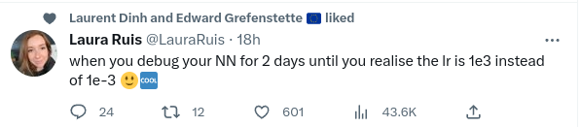
Machine Learning bugs

Slide 4
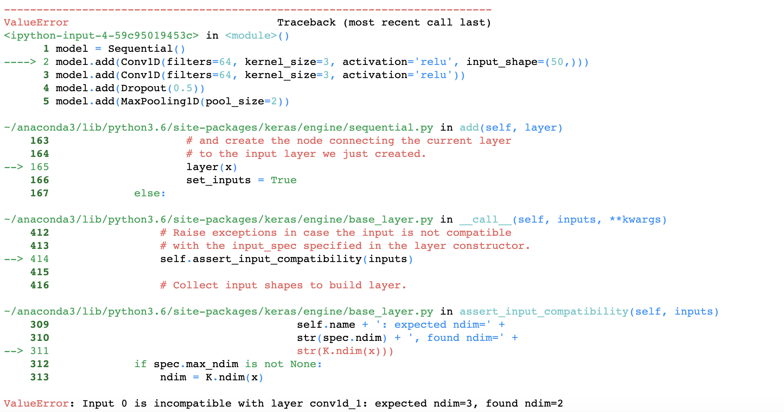
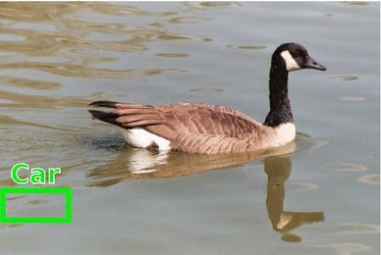
Machine Learning bugs
syntactic
functional

Slide 5
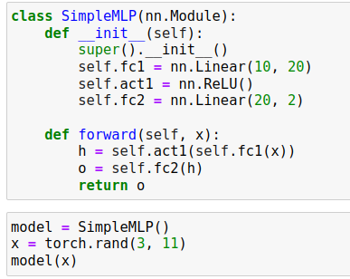

Wrong tensor shape
one of the most common errors is when the tensor shape is incompatible with the current operation
can be easy to figure out when the input data has the wrong shape

Slide 6
Wrong tensor shape
one of the most common errors is when the tensor shape is incompatible with the current operation
can be easy to figure out when the input data has the wrong shape
typical scenarios:
images: input Tensor has shape B x 3 x W x H instead of B x (3 x W x H)
time series: input Tensor has shape HiddenSize x timesteps instead of timesteps x HiddenSize
Notes:
other examples: network has input shape 3xWxH but receives greyscale image, at test time input is (3 X W X H) instead of (1 x 3 x W x H)

Slide 7
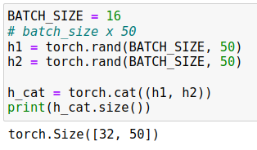
Wrong tensor shape (2)
other shape mismatches may happen during feedforward
tensors are manipulated using different operating (slice, concat, max, reshape etc.)
the resulting tensor shape no longer matches with the next layer
scenario: concatenating two tensors on the wrong dimension:
cat function concatenates on the 1st dimension by default!

Slide 8
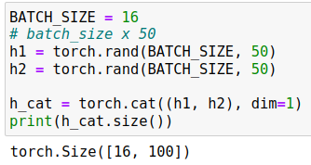
Wrong tensor shape (2)
other shape mismatches may happen due to feedforward manipulations
tensors are manipulated using different operating (slice, concat, max, reshape, squeeze etc.)
the resulting tensor shape no longer matches with the next layer
scenario: concatenating two tensors on the wrong dimension:
good practice: specify dimensions explicitly whenever possible (dim argument)
cat function concatenates on the 1st dimension by default!
the two input tensors are correctly concatenated
Notes:
other example: softmax over wrong dimension when predicting pixelwise value

Slide 9
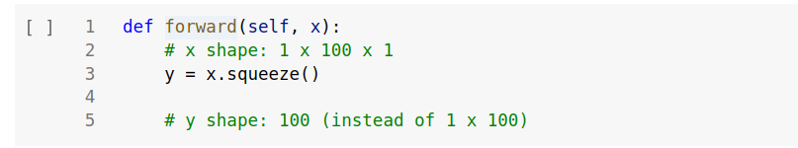
Wrong tensor shape (2)
other shape mismatches may happen due to feedforward manipulations
tensors are manipulated using different operating (slice, concat, max, reshape, squeeze etc.)
the resulting tensor shape no longer matches with the next layer
scenario: when batch_size=1, squeeze removes batch dimension as well:
good practice: explicitly specify squeeze dimensions (dim argument)
Notes:
other example: softmax over wrong dimension when predicting pixelwise value

Slide 10
Wrong tensor shape (3)
scenario: last batch in a dataset may have 1st dimension != batch_size:
why? let’s say batch_size=32
DataLoader loads 32 elements until it exhausts all the dataset elements
if dataset has 3216 elements => last batch has 16 elements
Notes:
conv1d

Slide 11

Wrong tensor shape (3)
scenario: last batch in a dataset may have 1st dimension != batch_size:
why? let’s say batch_size=32
DataLoader loads 32 elements until it exhausts all the dataset elements
if dataset has 3216 elements => last batch has 16 elements
if code assumes output size is batch_size, shape errors may appear:
input size no longer matches first linear layer!
Notes:
conv1d

Slide 12
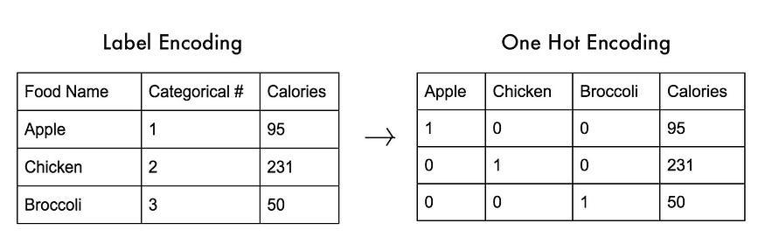
Wrong tensor shape (4)
labels are one-hot but loss function expects scalar [0, num_classes-1]
source: https://www.thetalkingmachines.com/article/beginners-guide-debugging-tensorflow-models
Notes:
conv1d

Slide 13
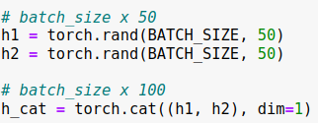
Wrong tensor shape (5)
good practices:
write down tensor shapes after each operation, this will make writing and debugging shape issues more easily
Notes:
conv1d

Slide 14
Wrong tensor shape (5)
good practices:
write down tensor shapes after each operation, this will make writing and debugging shape issues more easily
carefully read Pytorch documentation for layers (linear, conv2d etc), operations (concat, reshape, etc.) and loss functions
documentation snippet from CrossEntropyLoss in Pytorch
Notes:
conv1d

Slide 15
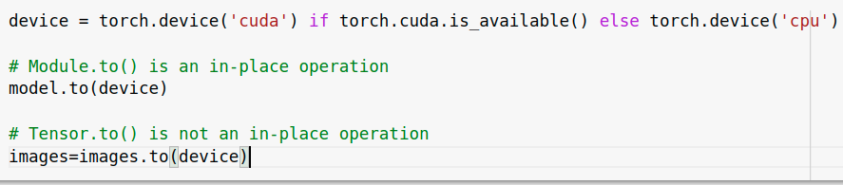
Wrong tensor device
tensors must be on the same device to perform most operations (no cpu-cuda or cuda1-cuda2 allowed)
typical errors:
model was moved to GPU but input data is still on CPU due to .to() operation
model was loaded from a checkpoint but we forgot to move it to GPU
forgot to move labels to GPU
tip: write device agnostic code to easily switch between the two

Slide 16
Wrong tensor device (2)
tips:
write device agnostic code to easily switch between the two
make sure model, inputs and labels are stored on the same device
Notes:
CUDA memory errors

Slide 17
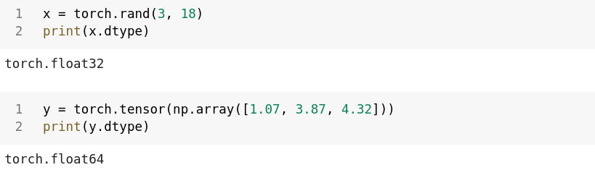
Wrong tensor type
input data and network mismatch:
parameters in torch.nn layers have type float32 (Float) by default
if the dataset is a NumPy array, it gets converted to Tensors of type float64 (Double), which are incompatible with the layers

Slide 18
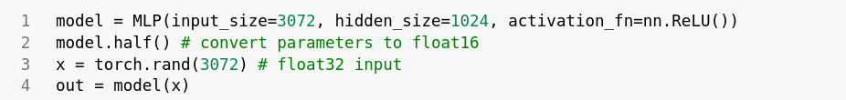
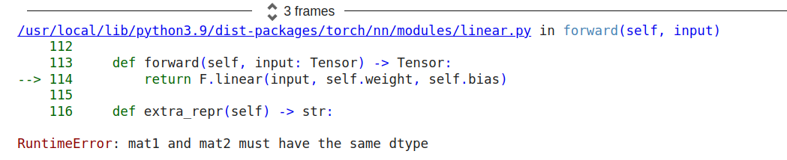
Wrong tensor type (2)
input data and network mismatch:
pretrained model parameters have half-precision (float16)
input is read as float32

Slide 19
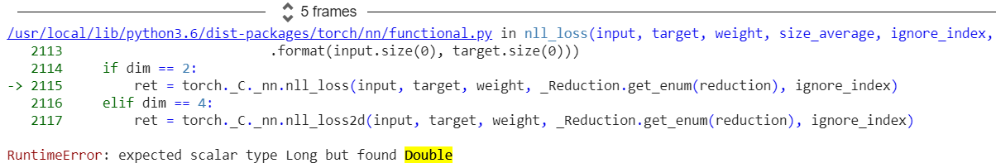
Wrong tensor type (3)
labels and loss mismatch:
labels are read as Float Tensors
we forget to convert them to Long Tensors, required by CrossEntropyLoss

Slide 20
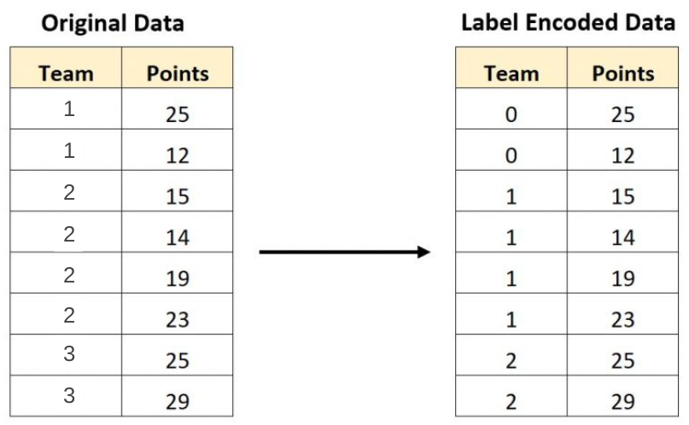
Wrong tensor range
labels are stored as {1,2,...,C} instead of {0,1,...,C-1}
this throws an error in the cost function when accessing the score or label with index C (out of range)
Notes:
conv1d

Slide 21
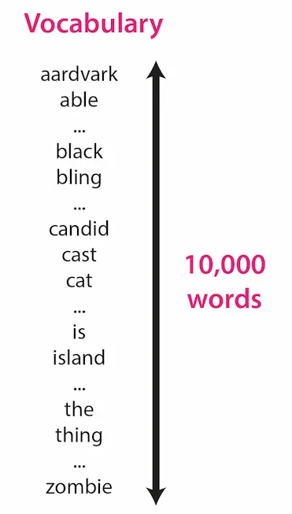
Wrong tensor range (2)
when working with text data, each word has a unique index {0..V-1}
for V = 10000, x[10000] results in an ‘index out of range’ error
source
Notes:
conv1d

Slide 22
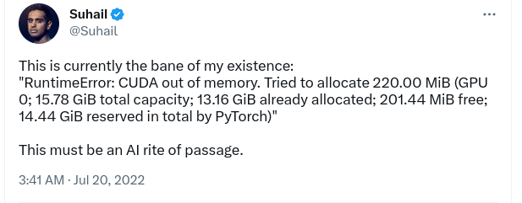
Out of memory errors
Notes:
conv1d

Slide 23
Out of memory errors (2)
issue: pretrained model doesn’t fit into single GPU memory
GPT3 has 175B parameters => requires 700GB memory to store in float32 format
maximum memory in a single GPU is 80GB (as of 2023)
solution: pick smaller model
GPTJ-6B requires 12GB GPU memory in half-precision (float16)
Notes:
conv1d

Slide 24
Out of memory errors (3)
model fits into GPU memory
issue: at test time, out of memory error occurs during feedforward
solutions:
make sure feedforward code is wrapped in torch.no_grad(), which disables gradient calculation and reduces memory consumption
reduce batch size
feed shorter sequences (if working with text/time series etc.)
Notes:
conv1d

Slide 25
Out of memory errors (3)
model fits into GPU memory
issue: at train time, out of memory error occurs during feedforward
solutions:
check for memory leaks (detach loss from computational graph before storing it)
reduce model size:
use less layers, smaller layer size etc.
train with mixed precision (float16) / quantization (int8)
reduce batch size
reduce input size:
downsize image/video
train with shorter sequences (text, time series etc.)
Notes:
conv1d

Slide 26
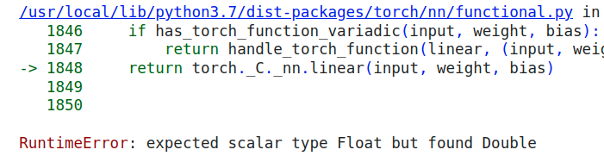
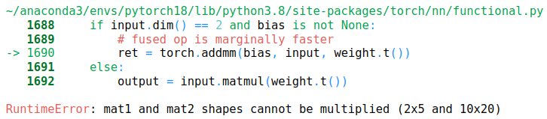
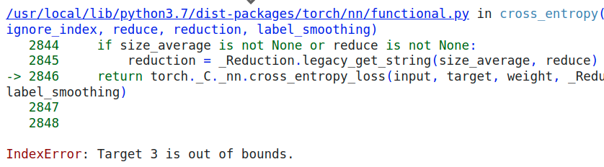
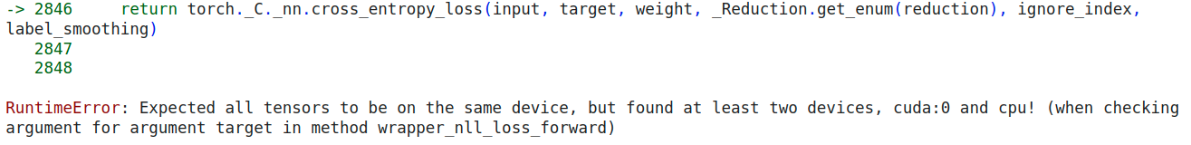
Syntactic Issues - recap
type errors
shape errors
range errors
device errors

Slide 27
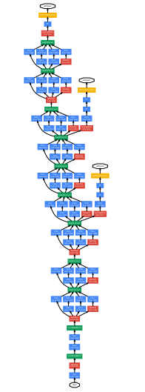


Syntactic Issues - recap
shape errors
type errors
OOM errors
nn layer (float32)
float64
device errors
range errors
x[3]
Inception network
Notes:
GPU Icon source: https://thenounproject.com/icon/gpu-1907650/
CPU Icon source: https://thenounproject.com/icon/cpu-2308475/

Slide 28

Machine Learning bugs
syntactic
functional

Slide 29
Machine Learning functional bugs
neural network trains, but the model’s performance is bad/suboptimal
there are many sources of errors:
logic errors (typos, wrong inputs, wrong labels, incorrect arguments)
bad model hyperparameters
dataset issues

Slide 30
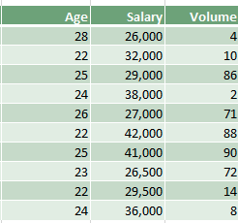
Numerical issues
normalization/standardization is:
missing
computed over the wrong dimension
Notes:
https://www.kdnuggets.com/2020/04/data-transformation-standardization-normalization.html

Slide 31
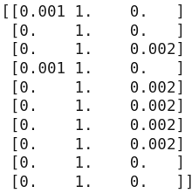

Numerical issues
normalization/standardization is:
missing
computed over the wrong dimension
Notes:
https://www.kdnuggets.com/2020/04/data-transformation-standardization-normalization.html

Slide 32
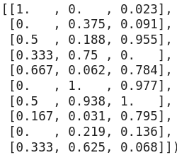
Numerical issues
normalization/standardization is:
missing
computed over the wrong dimension
Notes:
https://www.kdnuggets.com/2020/04/data-transformation-standardization-normalization.html

Slide 33
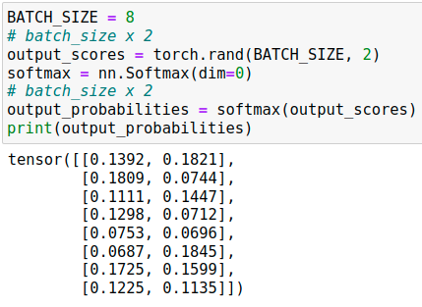
Numerical issues (2)
softmax is:
applied over the wrong dimension
Notes:
conv1d

Slide 34
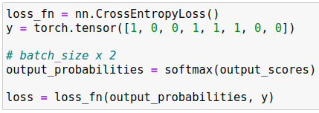
Numerical issues (2)
softmax is:
applied over the wrong dimension unnecessary
nn.CrossEntropyLoss() requires raw unnormalized scores as input
Notes:
conv1d

Slide 35
Numerical issues (3)
train/evaluation mode mismatch:
when model is set in eval() mode, some operations behave differently (Dropout, Batch Normalization etc.)
common mistake: at the end of an epoch, after evaluation, model is NOT set back to train mode, which results in unwanted behaviour:
dropout is disabled during training
batch normalization uses running estimates of mean and variance during training instead of computing current batch statistics
Notes:
conv1d

Slide 36
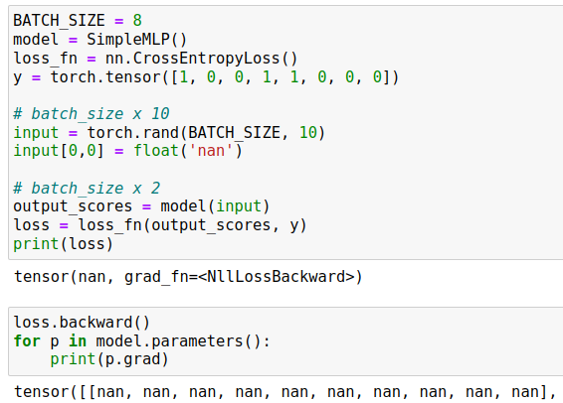
Numerical issues (4)
NaN (not a number) value appears in input data by mistake (missing/corrupted data, preprocessing error etc.)
no errors raised during:
feedforward
loss computation
backpropagation
tips: use torch.isnan(x).any() to check input tensor x
Notes:
ohter NaN causes: https://stackoverflow.com/questions/33962226/common-causes-of-nans-during-training

Slide 37
Numerical issues (5)
±Inf (infinity) value shows up in loss or in some intermediate output
possible causes:
learning rate too high => loss blows up
log(small value) = -inf
exp(large value) = +inf
tips:
decrease learning rate
gradient clipping (rescale gradient if norm > threshold)
log(x+eps)
Notes:
conv1d

Slide 38
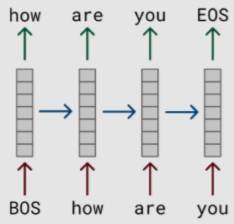
Input issues
in language models, for each input word you have to predict the next word
labels = inputs shifted by one to the left
BOS = beginning of sentence, EOS = end of sentence
Notes:
conv1d

Slide 39
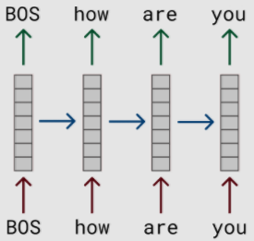
Input issues
in language models, for each input word you have to predict the next word
labels = inputs shifted by one to the left
if labels are not shifted properly, model solves different task by mistake
in this example, model predicts its own input (easy task)
BOS = beginning of sentence, EOS = end of sentence
Notes:
conv1d

Slide 40
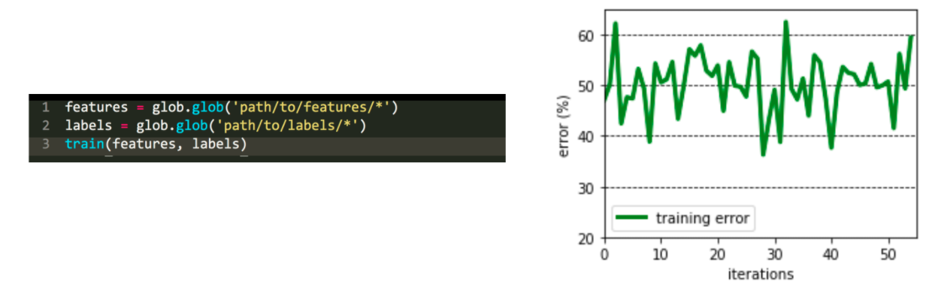
Input issues (2)
examples and labels are read from individual files
what is the issue?
source: https://fullstackdeeplearning.com/spring2021/lecture-7/
Notes:
conv1d

Slide 41
Input issues (2)
examples and labels are read from individual files
what is the issue?
files are read in random order, features[i] and labels[i] are not related
source: https://fullstackdeeplearning.com/spring2021/lecture-7/
Notes:
conv1d

Slide 42
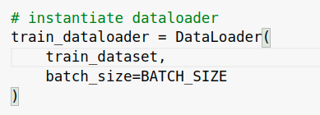
Input issues (3)
what is the issue?
Notes:
conv1d

Slide 43
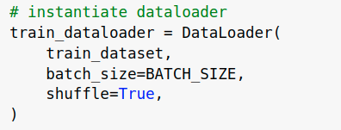
Input issues (3)
what is the issue?
training examples are not shuffled
Notes:
conv1d

Slide 44


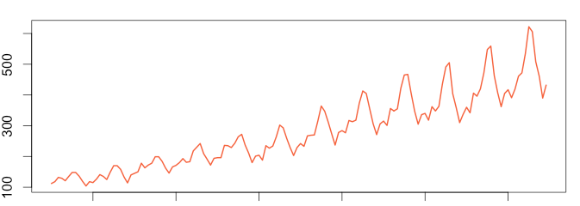
Dataset issues
dataset augmentation is commonly employed to improve performance
however, some augmentations are not meaningful and actually hurt the ability of the model to generalize:
flipping/rotating logos may not improve logo recognition
shifting or flipping time series changes its meaning
Notes:
conv1d

Slide 45
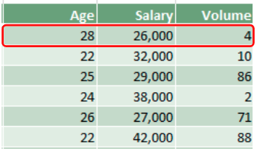
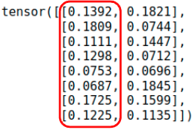


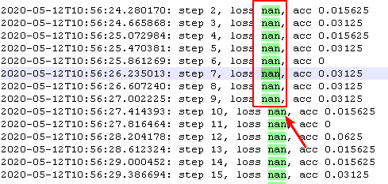


Functional Issues - recap
numerical errors (bad normalization, softmax over the wrong dimension, train/eval model mismatch etc.)
input issues (data not shuffled, out of order labels, input is not fed correctly to model etc.)
cat
dog

Slide 46
Debugging plan
run code and fix syntactic bugs (shape/device/type mismatches, OOM issues)
overfit model on a few (1-2) examples
if training loss ~0, start training on full dataset
if not, check for invisible bugs:
manually check input:
lots of zeros or NaN (preprocessing error, corrupted data)
duplicated rows (dataset contains duplicates, augmentation bug)
all batch examples have the same label (no shuffling)
check the arguments:
softmax taken over the correct dimensions
loss function receives the correct output (unnormalized or normalized scores)
start training on the full dataset
inspect loss/metric learning curves
we may still have invisible bugs at this point! (train data leaks into validation, bug when measuring validation error etc.)

Slide 47
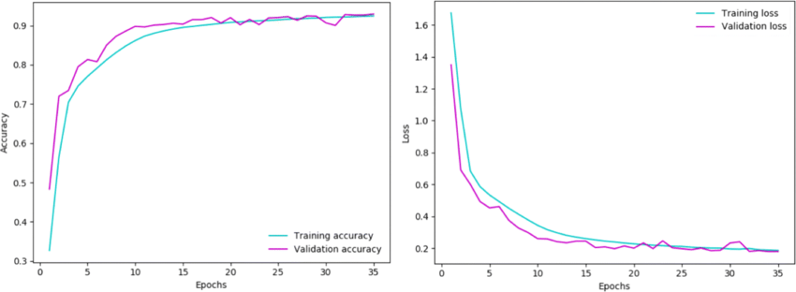
Inspecting learning curves
We plot:
training loss and validation loss curves
training metric and validation metric curves (where metric = accuracy, F1, BLEU etc.)
Based on the shape and values of these learning curves:
we inspect whether the model is training correctly
we choose the best model
source

Slide 48
Learning curves scenarios
training loss increases
training loss stops decreasing
training loss decreases slowly
training loss decreases

Slide 49
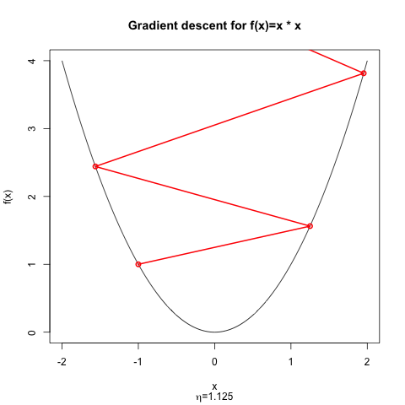
Training loss increases
Q: what does it usually indicate?
https://stats.stackexchange.com/questions/364360/how-can-change-in-cost-function-be-positive
Notes:
https://stats.stackexchange.com/questions/352036/what-should-i-do-when-my-neural-network-doesnt-learn/352037#352037

Slide 50
Training loss increases
Q: what does it usually indicate?
A: the learning rate may be too high, moving the parameters away from the local minimum
https://stats.stackexchange.com/questions/364360/how-can-change-in-cost-function-be-positive
Notes:
https://stats.stackexchange.com/questions/352036/what-should-i-do-when-my-neural-network-doesnt-learn/352037#352037

Slide 51
Training loss increases
Q: what does it usually indicate?
A: the learning rate may be too high, moving the parameters away from the local minimum
solution: decrease learning rate
https://stats.stackexchange.com/questions/364360/how-can-change-in-cost-function-be-positive
Notes:
https://stats.stackexchange.com/questions/352036/what-should-i-do-when-my-neural-network-doesnt-learn/352037#352037

Slide 52
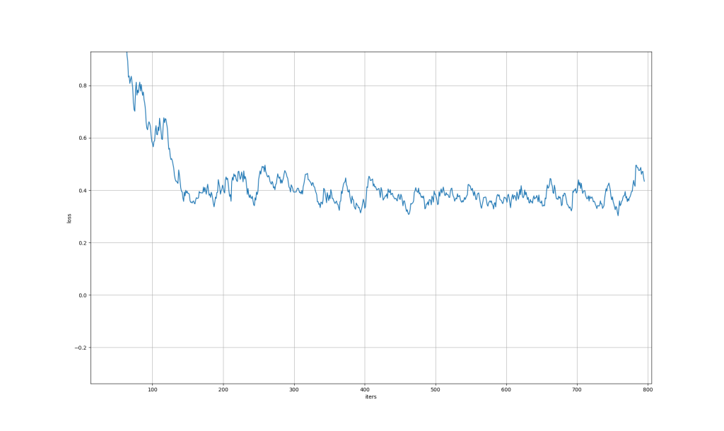
Training loss stops decreasing
Q: what could it mean?
training loss
iterations
source: https://jumabek.wordpress.com/2017/03/21/781/
Notes:
learning rate plateau: https://analyticsindiamag.com/what-is-the-plateau-problem-in-neural-networks-and-how-to-fix-it/
dying ReLU

Slide 53
Training loss stops decreasing
Q: what could it mean?
A: it may still indicate a learning rate that is too high
training loss
iterations
source: https://jumabek.wordpress.com/2017/03/21/781/
Notes:
learning rate plateau: https://analyticsindiamag.com/what-is-the-plateau-problem-in-neural-networks-and-how-to-fix-it/
dying ReLU

Slide 54
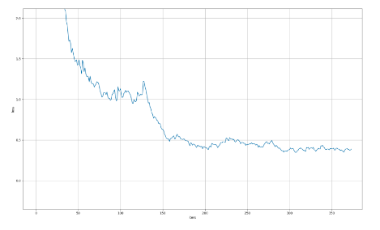
Training loss stops decreasing
Q: what could it mean?
A: it may still indicate a learning rate that is too high
solutions:
if it happens in the early stages of training, start with a smaller learning rate (halve it)
training loss
iterations
source: https://jumabek.wordpress.com/2017/03/21/781/
Notes:
learning rate plateau: https://analyticsindiamag.com/what-is-the-plateau-problem-in-neural-networks-and-how-to-fix-it/
dying ReLU

Slide 55
Training loss stops decreasing
Q: what could it mean?
A: it may still indicate a learning rate that is too high
solutions:
if it happens in the early stages of training, start with a smaller learning rate (halve it)
if training loss reaches plateau after a few epochs, use learning rate scheduler (ReduceLROnPlateau - reduces lr when metric stops improving)
training loss
iterations
source: https://jumabek.wordpress.com/2017/03/21/781/
Notes:
learning rate plateau: https://analyticsindiamag.com/what-is-the-plateau-problem-in-neural-networks-and-how-to-fix-it/
dying ReLU

Slide 56
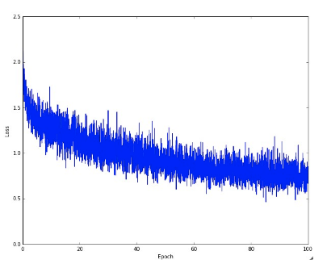
Training loss decreases slowly
Q: what could it mean?
training loss
epochs
source: https://cs231n.github.io/neural-networks-3/
Notes:
learning rate plateau: https://analyticsindiamag.com/what-is-the-plateau-problem-in-neural-networks-and-how-to-fix-it/
dying ReLU

Slide 57
Training loss decreases slowly
Q: what could it mean?
A: it could indicate a learning rate that is too low (loss decreases linearly)
solution: higher learning rate
training loss
epochs
source: https://cs231n.github.io/neural-networks-3/
Notes:
learning rate plateau: https://analyticsindiamag.com/what-is-the-plateau-problem-in-neural-networks-and-how-to-fix-it/
dying ReLU

Slide 58
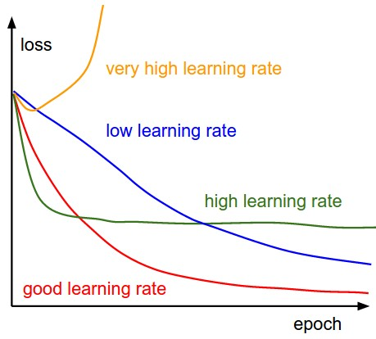
Shape of training loss curves
the shape of the loss curve provides clue about the learning rate:
loss increases early in the training (very high learning rate)
loss decreases quickly then reaches a plateau (high learning rate)
loss decreases linearly (potentially low learning rate)
however, we care more than the shape
source: https://cs231n.github.io/neural-networks-3/

Slide 59
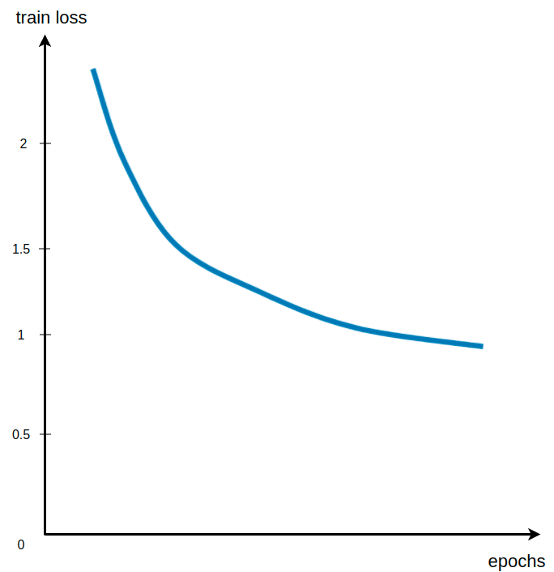
Is this a good training curve?
if training loss stabilizes around a value that is still high, the model is underfitting
solutions:
the model is too small to learn the training dataset => increase model capacity (more layers, more neurons per layer)
the model has enough capacity, but:
it is heavily regularized => reduce regularization (smaller Dropout rate, smaller L2 coefficient)
it has a lot of frozen parameters => unfreeze some of them

Slide 60
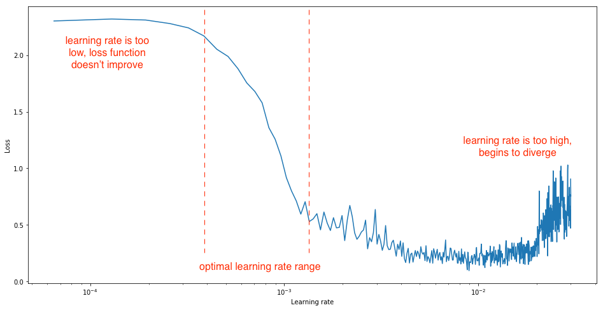
How to pick a good learning rate range?
let model train and decrease learning rate for each new batch
a good learning rate range:
starts when loss begins to drop steeply
ends when loss slows down, wiggles or starts increasing
source: https://www.jeremyjordan.me/nn-learning-rate/
Notes:
resources: http://www.bdhammel.com/learning-rates/

Slide 61
Learning curves scenarios
we have looked at possible issues with training curves!
training loss increases
training loss stops decreasing
training loss decreases slowly
training loss decreases

Slide 62
Learning curves scenarios
we have looked at possible issues with training curves!
training loss increases
training loss stops decreasing
training loss decreases slowly
training loss decreases, but:
validation loss >> training loss
validation loss ≈ training loss, then diverges
validation loss ≈ training loss
validation loss < training loss
validation loss << training loss
both validation loss and validation accuracy increase
however, a good training curve says nothing about the generalization capability of the model => inspect validation curves!

Slide 63
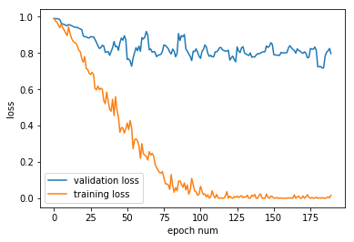
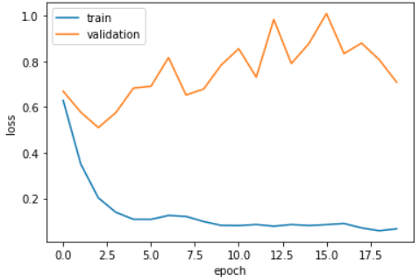
Validation loss >> training loss
Q: overfitting or underfitting?
source
source
Notes:
other scenarios: https://stackoverflow.com/questions/55444737/validation-loss-much-higher-than-training-loss

Slide 64
Validation loss >> training loss
Q: overfitting or underfitting?
A: model is overfitting
training loss decreases, while validation loss either gets worse or doesn’t improve
model learns patterns that are not useful outside training set
solutions:
add regularization (Dropout/L2)
reduce model size (fewer layers/neurons per layer)
add more training data
source
source
Notes:
other scenarios: https://stackoverflow.com/questions/55444737/validation-loss-much-higher-than-training-loss

Slide 65
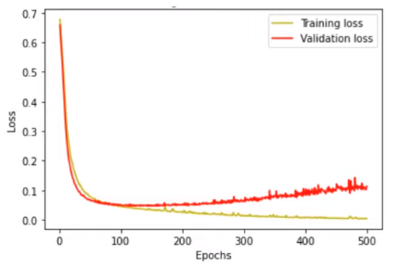
Validation loss tracks train loss then diverges
Q: overfitting or underfitting?
source: https://www.youtube.com/watch?v=p3CcfIjycBA

Slide 66
Validation loss tracks train loss then diverges
Q: overfitting or underfitting?
A: overfitting from epoch 100 onwards
validation loss tracks training loss, but diverges from epoch 100
solutions:
early stop at epoch 100
add regularization (Dropout)
source: https://www.youtube.com/watch?v=p3CcfIjycBA

Slide 67
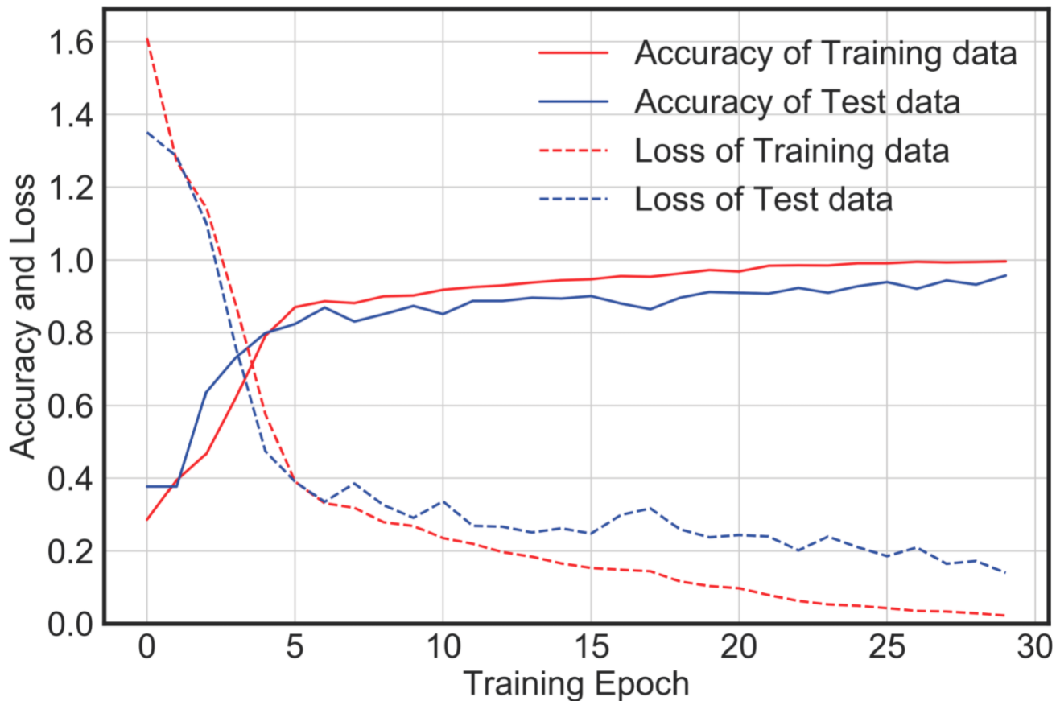
Validation loss ≈ training loss
Q: overfitting or underfitting?
source: https://www.mdpi.com/1424-8220/20/9/2710/htm
Notes:
other good fit: https://machinelearningmastery.com/learning-curves-for-diagnosing-machine-learning-model-performance/

Slide 68
Validation loss ≈ training loss
Q: overfitting or underfitting?
A: good fit
training and validation loss approach 0, with small gap between them
validation loss usually (but now always) slightly higher than training loss
training and validation accuracy also increase simultaneously (they are not always correlated with loss curves)
source: https://www.mdpi.com/1424-8220/20/9/2710/htm
Notes:
other good fit: https://machinelearningmastery.com/learning-curves-for-diagnosing-machine-learning-model-performance/

Slide 69
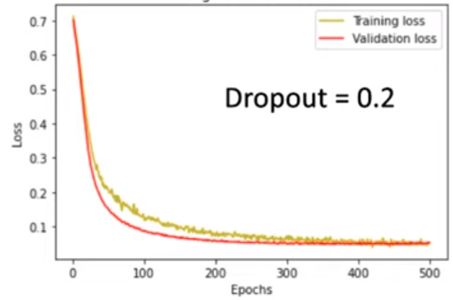
Validation loss < training loss
Q: validation loss should normally be slightly higher than training loss, why is it lower here?
source: https://www.youtube.com/watch?v=p3CcfIjycBA

Slide 70
Validation loss < training loss
Q: validation loss should normally be slightly higher than training loss, why is it lower here?
A: the model is still a good fit if validation loss slightly lower than training loss
this effect may be due to Dropout, which disables some of the neurons during training
this lowers training performance at the expense of increased generalization during validation (when dropout is disabled)
source: https://www.youtube.com/watch?v=p3CcfIjycBA

Slide 71

Validation loss << training loss
Q: overfitting or underfitting?
source: https://machinelearningmastery.com/learning-curves-for-diagnosing-machine-learning-model-performance/
Notes:
more resources: https://stats.stackexchange.com/questions/187335/validation-error-less-than-training-error

Slide 72
Validation loss << training loss
Q: overfitting or underfitting?
A: neither
validation loss is much lower than training loss, which means the validation set is ‘easier’ for the model than the training set
this may point to potential problems with the validation set:
validation examples easier than training examples (due to some bug in the splitting process or augmenting training examples only)
some training examples leaked into the validation set
source: https://machinelearningmastery.com/learning-curves-for-diagnosing-machine-learning-model-performance/
Notes:
more resources: https://stats.stackexchange.com/questions/187335/validation-error-less-than-training-error

Slide 73


Both validation loss & accuracy increase
Q: lowest validation loss is at ~10k steps, but validation accuracy continues to increase after that, why?
source
Notes:
resources: https://stats.stackexchange.com/questions/282160/how-is-it-possible-that-validation-loss-is-increasing-while-validation-accuracy , https://arxiv.org/pdf/1706.04599.pdf , https://www.reddit.com/r/MachineLearning/comments/si7q6z/d_validation_metrics_improving_despite_validation/

Slide 74
Both validation loss & accuracy increase
Q: lowest validation loss is at ~10k steps, but validation accuracy continues to increase after that, why?
A: model is making fewer mistakes, but:
may be less certain when making correct predictions (correct probability goes from 0.9 to 0.6 => loss increases from 0.1 to 0.5)
may be more confident when making incorrect predictions (loss increases from 0.91 to 2.3)
better checkpoint
labels | 0 | 1
old predictions | 0.6 | 0.4
new predictions | 0.9 | 0.1
source
Notes:
resources: https://stats.stackexchange.com/questions/282160/how-is-it-possible-that-validation-loss-is-increasing-while-validation-accuracy , https://arxiv.org/pdf/1706.04599.pdf , https://www.reddit.com/r/MachineLearning/comments/si7q6z/d_validation_metrics_improving_despite_validation/

Slide 75
Learning curves TL;DR
validate that the model is training correctly:
train/validation loss curves show a good fit
train/validation loss curves indicate beginning of overfit
choose the best model:
we usually care about the metric on the validation set
apply early stopping at the epoch where validation metric (accuracy/F1/etc.) stops increasing

